Slide 1

FINAL PROJECT Daxeshkumar Patel MGT 2148 – Business Analytics and Decision Making Mohammad Raahemi 11th August 2023

Slide 2

TABLE OF CONTENT
INTRODUCTION
DATA GATHERING AND CLEANING FOR ANALYSIS
MEAN, MEDIAN AND MODE OF DATA
VISUAL ANALYSIS BY CHART AND DIAGRAM
HYPOTHESIS TESTING
REGRESSION
REFERENCE

Slide 3

INTRODUCTION
Data-driven decision-making is becoming a crucial strategy for businesses
Business Analysis principles through a meticulous examination of a rich YouTube dataset, encompassing essential information about YouTube channels, their subscribers, viewership, uploads, geographical origins, and the years of their creation.
SCOPE OF ANALYSIS
VISUAL INSIGHTS

Slide 4

DATA GATHERING AND CLEANING FOR ANALYSIS
Global YouTube statistics dataset of year 2022 from https://www.kaggle.com
995 YouTube channels worldwide
Removed certain inconsistencies
some data cells were lacking information, others contained unrelated data, and a few even presented negative counts
transformed the original dataset into a refined dataset.
785 YouTube channels which became popular

Slide 5
MEAN, MEDIAN AND MODE OF DATA
 | CREATER_YEAR | SUBSCRIBERS | VIDEO VIEWS | UPLOADS | POPULATION | YEARLY EARNING (USD)
MEAN | 2013 | 22779745 | 11552851491 | 11372 | 443745787 | 522707
Mean:
Median:
 | CREATER_YEAR | SUBSCRIBERS | VIDEO VIEWS | UPLOADS | POPULATION | YEARLY EARNING (USD)
MEDIAN | 2013 | 17500000 | 7776706184 | 1021 | 328239523 | 243700
 | CREATER_YEAR | SUBSCRIBERS | VIDEO VIEWS | UPLOADS | POPULATION | YEARLY EARNING (USD)
MODE | 2014 | 12500000 | #N/A | 147 | 328239523 | 1100000
Mode:

Slide 6
Key take aways (MEAN, MEDIAN AND MODE Analysis)
CREATOR YEAR:
Maximum creators came on platform during the year 2014 are successful.
SUBSCRIBERS:
Wide gap between the mean (22,779,745) and median (17,500,000) – Presence of Outliers
Mode subscriber count at 12,500,000 - majority of creators falls within a Similar Subscriber Range
VIEWS:
No single value occurs most frequently - diverse range of video views
Considerable difference between the mean and median - Few creators with extremely high view counts

Slide 7
Key take aways (MEAN, MEDIAN AND MODE Analysis)
4. UPLOADS:
low mode – Most Creator have dataset have a relatively moderate number of uploads.
5. POPULATION:
Identical median and mode population - focused on creators from a specific regions
6. YEARLY EARNING (USD):
difference between the mean and median earnings - potential outliers with high earnings
mode value for earnings at $1,100,000 - Majority creators with earnings around this value

Slide 8

VISUAL ANALYSIS BY CHART AND DIAGRAM

Slide 9
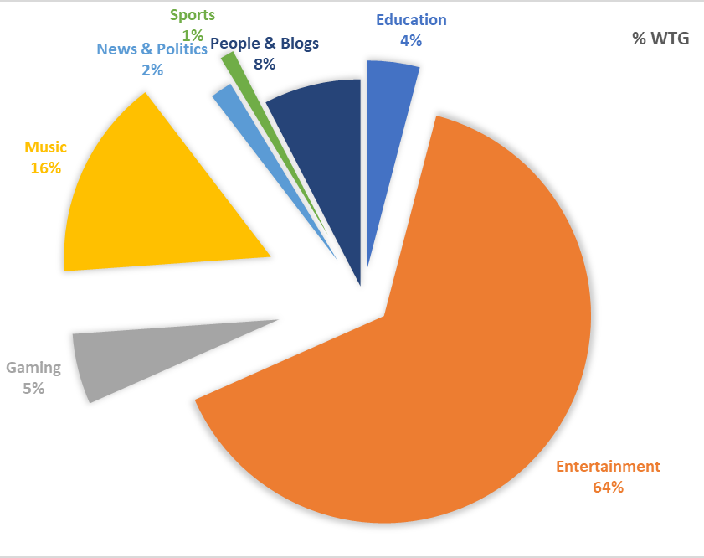
Pie Chart Analysis for Subscribers Distribution by Category of content
CONTENT DOMINANCE:
The Entertainment category commands the largest share of subscribers, accounting for 64.30% of the total.
Engagement:
second-largest share (15.72%.)
demonstrates a diverse range of content.
Education's Impact:
notable portion with 4.07%
content is relevant and engaging to a significant portion for business

Slide 10
Pie Chart Analysis for Subscribers Distribution by Category of content
Niche Categories:
Gaming and People & Blogs categories contribute same which is approximately 13% of subscribers
niche categories indicate the presence of dedicated audiences
Limited Engagement:
Sports and News & Politics categories hold around 1%.
relatively limited audience
Marketing Insights:
Entertainment and Music categories for targeted marketing campaigns.
Niche categories - reaching engaged, specialized audiences.

Slide 11
Bar Chart analysis for Yearly earning of top 10 YouTube Channels
Disparities in yearly earnings among the top 10 YouTube channels.
Monetization Strategies:
The varying earnings highlight the diverse monetization strategies that channels employ, including ad revenue, partnerships, merchandise sales, and more.
Corporate vs. Independent Earnings:
High earnings of Zee Music Company and WWE suggest the revenue potential for established corporate entities on YouTube.
MrBeast and PewDiePie, however, can also compete significantly in terms of earnings.

Slide 12
Line Chart Analysis For Views Earned Of YouTube Channels Started In Different Years
Growth of Viewers and Audience Reach
YouTube channels started in the year 2006 and 2007 are getting the maximum views in other words they have best reach to audience.
YouTube should select those channels to run the advertisement for getting the better viewer reach.
Average Performing Creators
or the creator who has started in year 2011 and 2014 are getting average 800 billion views which should be second highest after year 2006-07, which makes them ideal for running the advertisement.

Slide 13
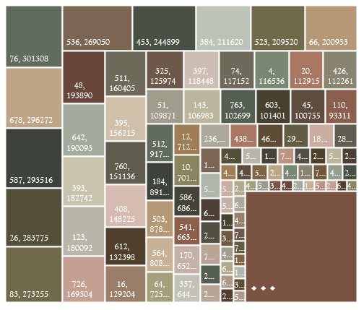
Tree-map Analysis for Video Uploaded by channels:
Ranking vs. Uploads:
There is no correlation between a channel's ranking and the number of videos uploaded. It is not mandatory to upload the maximum number of videos to get successful on YouTube.
Distribution of Uploads:
We can visualize the distribution of video uploads across the channels.
Majority of channels have a relatively low number of uploads, while a smaller number of channels have a significantly higher number of uploads.

Slide 14
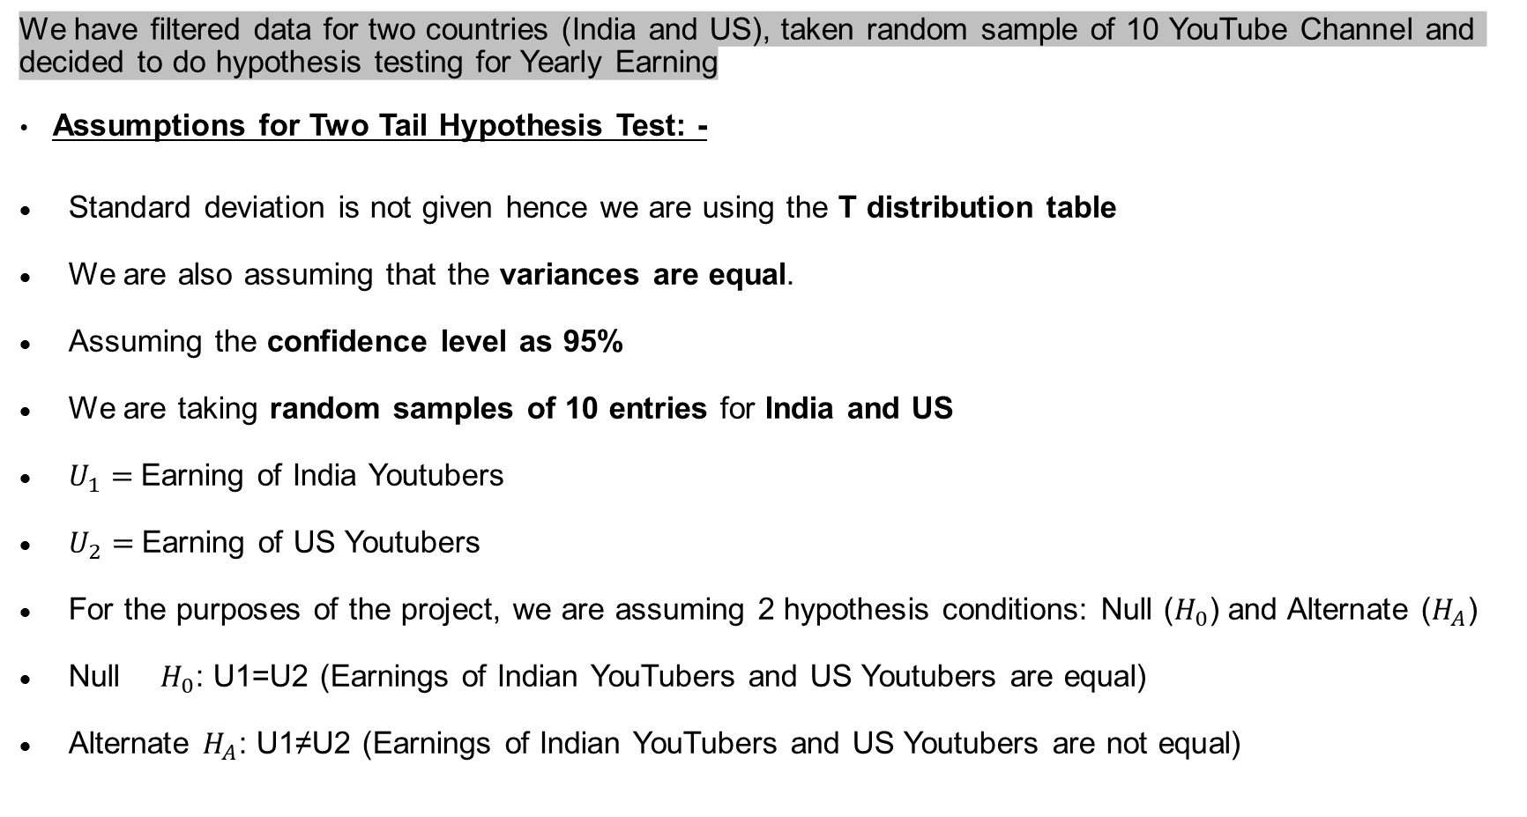
HYPOTHESIS TESTING - TWO TAIL
We have filtered data for two countries (India and US), taken random sample of 10 YouTube Channel and decided to do hypothesis testing for Yearly Earning
Assumptions for Two Tail Hypothesis Test: -
Standard deviation is not given hence we are using the T distribution table
We are also assuming that the variances are equal.
Assuming the confidence level as 95%
We are taking random samples of 10 entries for India and US
$U_{1}=$Earning of India Youtubers
$U_{2}=$Earning of US Youtubers
For the purposes of the project, we are assuming 2 hypothesis conditions: Null ($H_{0}$) and Alternate ($H_{A}$)
Null $H_{0}$: U1=U2 (Earnings of Indian YouTubers and US Youtubers are equal)
Alternate $H_{A}$: U1≠U2 (Earnings of Indian YouTubers and US Youtubers are not equal)

Slide 15
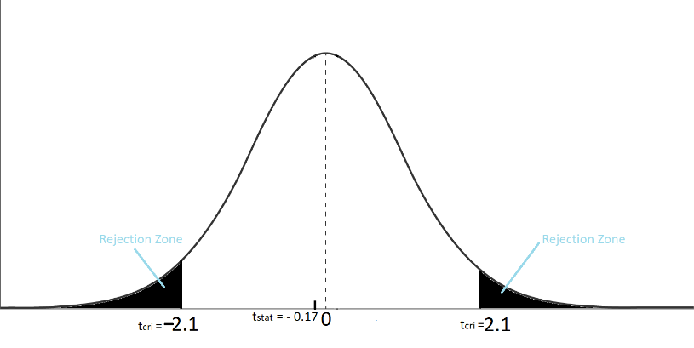
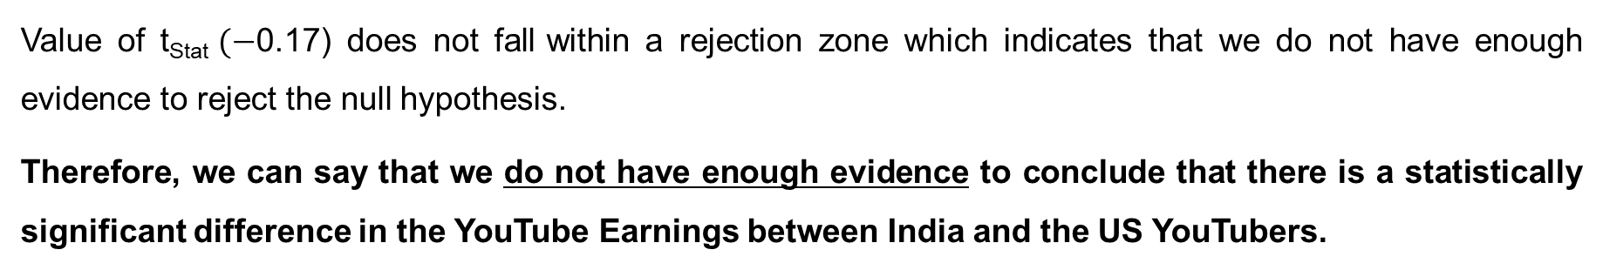
HYPOTHESIS TESTING - TWO TAIL
Result Output: -
Value of t_{Stat} $(−$0.17) does not fall within a rejection zone which indicates that we do not have enough evidence to reject the null hypothesis.
Therefore, we can say that we do not have enough evidence to conclude that there is a statistically significant difference in the YouTube Earnings between India and the US YouTubers.

Slide 16
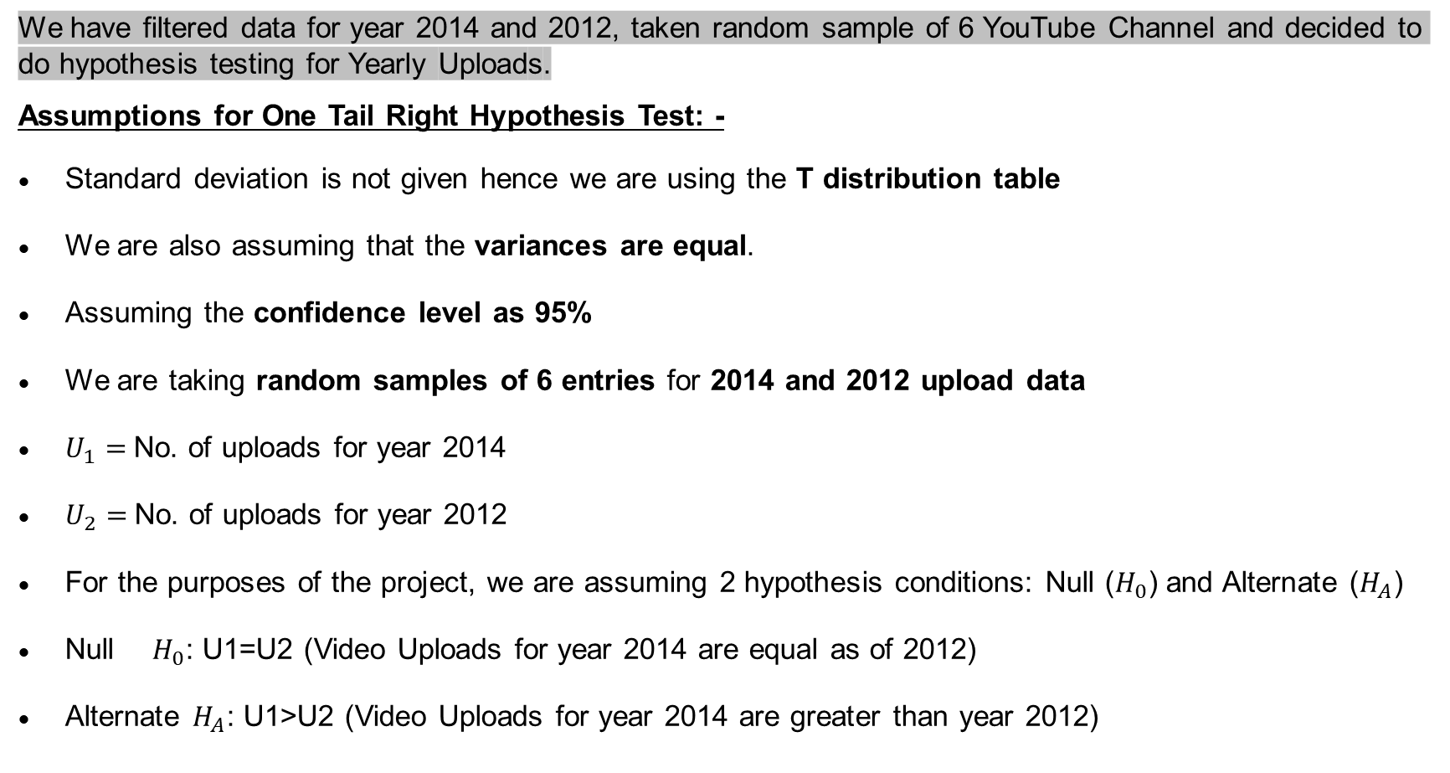
HYPOTHESIS TESTING - ONE TAIL RIGHT
We have filtered data for year 2014 and 2012, taken random sample of 6 YouTube Channel and decided to do hypothesis testing for Yearly Uploads.
Assumptions for One Tail Right Hypothesis Test: -
Standard deviation is not given hence we are using the T distribution table
We are also assuming that the variances are equal.
Assuming the confidence level as 95%
We are taking random samples of 6 entries for 2014 and 2012 upload data
$U_{1}=$No. of uploads for year 2014
$U_{2}=$No. of uploads for year 2012
For the purposes of the project, we are assuming 2 hypothesis conditions: Null ($H_{0}$) and Alternate ($H_{A}$)
Null $H_{0}$: U1=U2 (Video Uploads for year 2014 are equal as of 2012)
Alternate $H_{A}$: U1>U2 (Video Uploads for year 2014 are greater than year 2012)

Slide 17
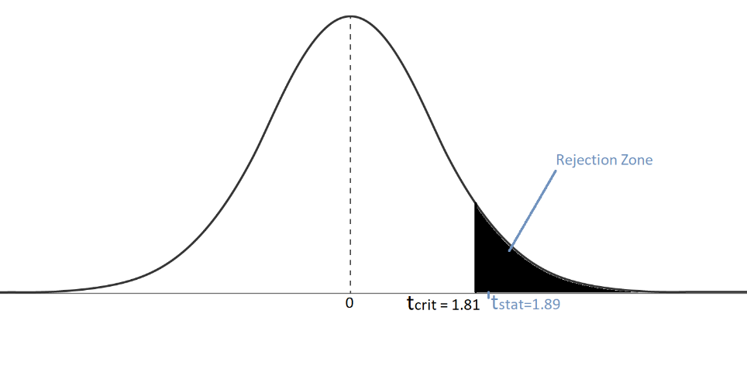
HYPOTHESIS TESTING - ONE TAIL RIGHT
Result Output: -
Value of t_{Stat} : 1.89 > t_{Crit} :1.81, hence value of t_{Stat} fall within a rejection zone which indicates that we have enough evidence to reject the null hypothesis.
Therefore, we can say that based on hypothesis testing, there is a significant difference in Video uploads between the years 2014 and 2012.

Slide 18
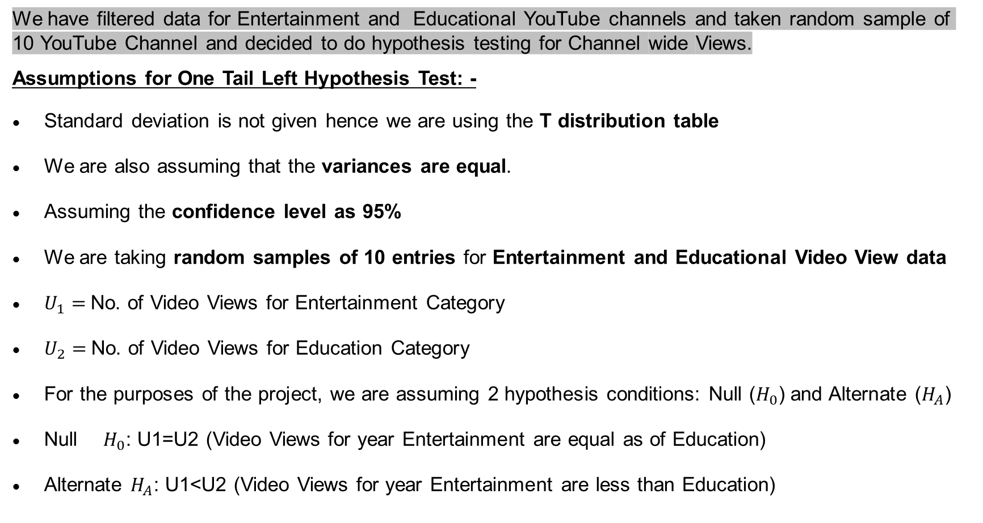
HYPOTHESIS TESTING - ONE TAIL LEFT
We have filtered data for Entertainment and Educational YouTube channels and taken random sample of 10 YouTube Channel and decided to do hypothesis testing for Channel wide Views.
Assumptions for One Tail Left Hypothesis Test: -
Standard deviation is not given hence we are using the T distribution table
We are also assuming that the variances are equal.
Assuming the confidence level as 95%
We are taking random samples of 10 entries for Entertainment and Educational Video View data
$U_{1}=$No. of Video Views for Entertainment Category
$U_{2}=$No. of Video Views for Education Category
For the purposes of the project, we are assuming 2 hypothesis conditions: Null ($H_{0}$) and Alternate ($H_{A}$)
Null $H_{0}$: U1=U2 (Video Views for year Entertainment are equal as of Education)
Alternate $H_{A}$: U1<U2 (Video Views for year Entertainment are less than Education)

Slide 19
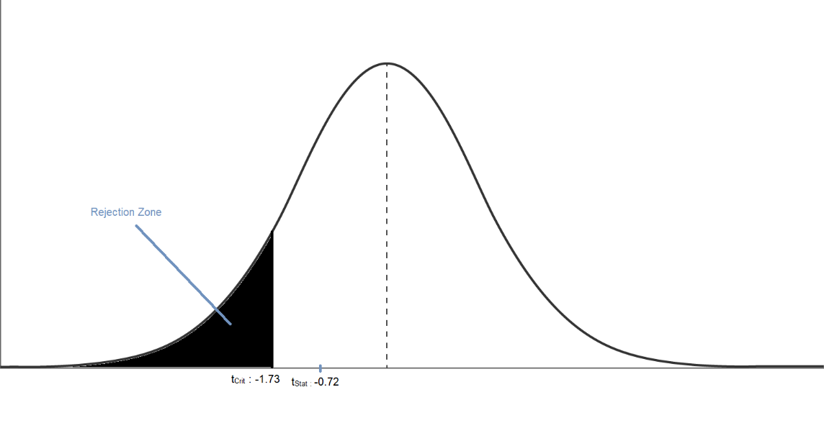
HYPOTHESIS TESTING – ONE TAIL LEFT
Result Output: -
Value of t_{Crit} : -1.73 < t_{Stat:} -0.72. Hence the value of t_{Stat} does not fall within a rejection zone which indicates that we don’t have enough evidence to reject the null hypothesis.
Therefore, we can say that based on the provided data, there is a no significant difference in Video Views between Entertainment and Education.

Slide 20
REGRESSION
Regression gives us the relationship between interval variables.
Values of one variable (Dependent Variable) based on other (Independent Variable) can be predicted by Regression Analysis.
There are two types of regression:
Simple Linear Regression: One Variable and One Independent Variable
Multiple Regression: One Variable and Multiple Independent Variables

Slide 21
A. Simple Linear Regression
Here we are taking the example of Canadian Youtubers considering their yearly earnings are dependent on their Subscriber count.
SCATTER DIAGRAM OF REGRESSION MODEL:

Slide 22
A. Simple Linear Regression

Slide 23
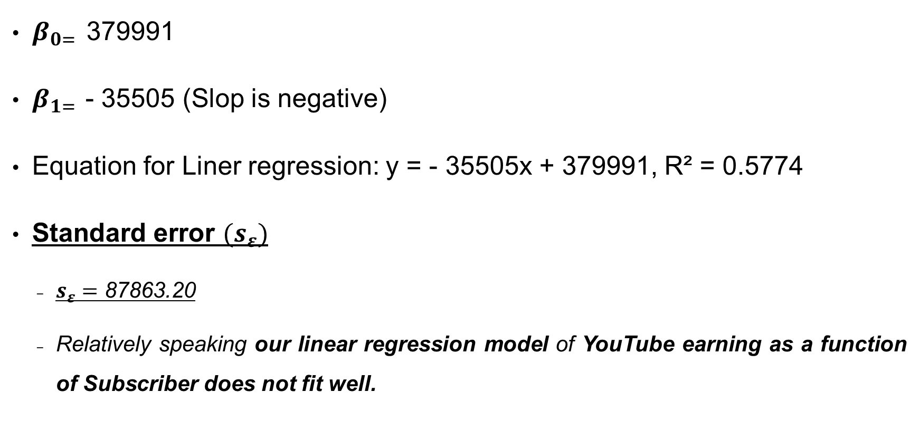
A. Simple Linear Regression (Key Takeaways)
$β_{0= }$379991
$β_{1= }$- 35505 (Slop is negative)
Equation for Liner regression: y = - 35505x + 379991, R² = 0.5774
Standard error $(s_{ε})$
$s_{ε}=$ 87863.20
Relatively speaking our linear regression model of YouTube earning as a function of Subscriber does not fit well.

Slide 24
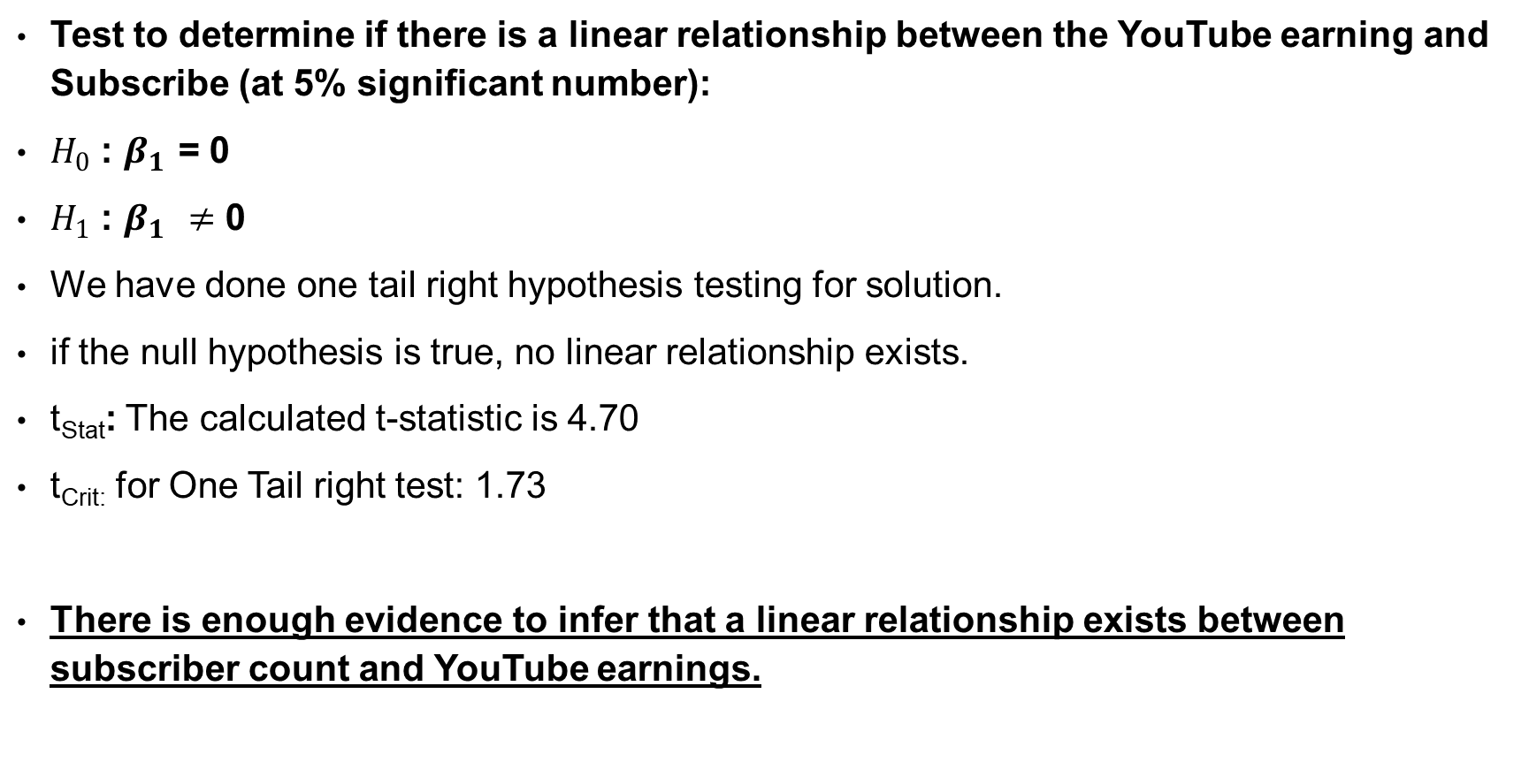
A. Simple Linear Regression (Key Takeaways)
Test to determine if there is a linear relationship between the YouTube earning and Subscribe (at 5% significant number):
$H_{0}$ : $β_{1 }$= 0
$H_{1}$ : $β_{1 }≠$ 0
We have done one tail right hypothesis testing for solution.
if the null hypothesis is true, no linear relationship exists.
t_{Stat}: The calculated t-statistic is 4.70
t_{Crit:} for One Tail right test: 1.73
There is enough evidence to infer that a linear relationship exists between subscriber count and YouTube earnings.

Slide 25
A. Simple Linear Regression (Key Takeaways)
Coefficient of Determinant (R²)
To measure the strength of the relationship we use coefficient of determinant (R²)
R² = 0.710680494
Which means 71.06% variation YouTube earning is expected by the variance in Subscriber count and remaining 28.94 is unexpected, due to error.
Coefficient of determinant does not have a critical value that enable us to draw conclusion however higher the R² better the model fits data.
If it R² is 1 then it would be considered as perfect match and if R² is 0 then it would be considered as no linear relation.
In our case R² is near to 1 hence we can say that model is better fit for the data taken.

Slide 26
B. MULTIPLE Regression
The simple linear regression model is used to determine the relationship. However in Multiple Regression method we use multiple independent variable to determine the single dependent variable.
Here we are taking the sample from dataset of top 20 Youtubers considering their yearly earnings are dependent on their Subscriber count, Video Views and number of videos uploaded.

Slide 27
B. MULTIPLE Regression

Slide 28

B. MULTIPLE Regression (Key Take Aways)
$β_{0= }$-793433.63
$β_{1= }$ 0.02
$β_{2= }$ 0.000013
$β_{3= }$ 21.58
Equation for Multiple regression: y = -793433.63 + 0.02 (subscribe) +0.000013 (Video Views) + 21.58 (Uploads)

Slide 29
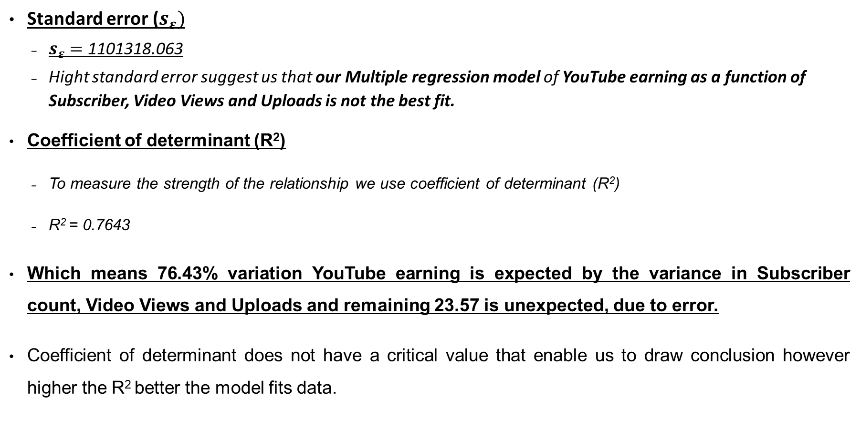
B. MULTIPLE Regression (Key Take Aways)
Standard error ($s_{ε})$
$s_{ε}=$ 1101318.063
Hight standard error suggest us that our Multiple regression model of YouTube earning as a function of Subscriber, Video Views and Uploads is not the best fit.
Coefficient of determinant (R²)
To measure the strength of the relationship we use coefficient of determinant (R²)
R² = 0.7643
Which means 76.43% variation YouTube earning is expected by the variance in Subscriber count, Video Views and Uploads and remaining 23.57 is unexpected, due to error.
Coefficient of determinant does not have a critical value that enable us to draw conclusion however higher the R² better the model fits data.

Slide 30
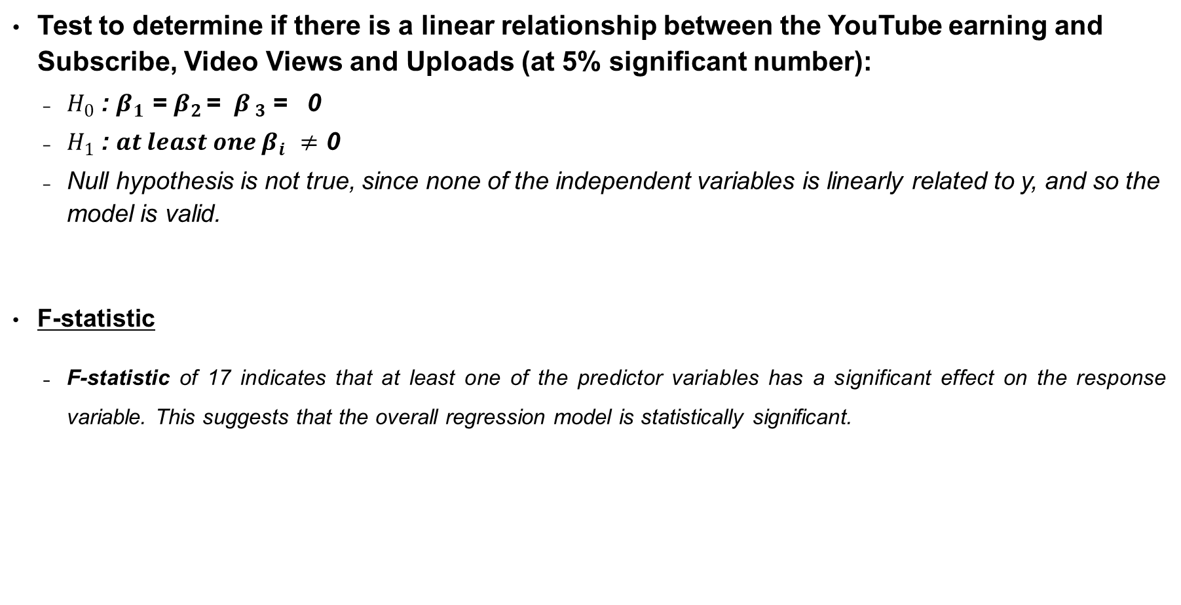
B. MULTIPLE Regression (Key Take Aways)
Test to determine if there is a linear relationship between the YouTube earning and Subscribe, Video Views and Uploads (at 5% significant number):
$H_{0}$ : $β_{1 }$= $β_{2 }$= $β_{ 3}$ = 0
$H_{1}$ : ${at least one β}_{i }≠$ 0
Null hypothesis is not true, since none of the independent variables is linearly related to y, and so the model is valid.
F-statistic
F-statistic of 17 indicates that at least one of the predictor variables has a significant effect on the response variable. This suggests that the overall regression model is statistically significant.

Slide 31
B. MULTIPLE Regression (Key Take Aways)
In conclusion, based on the analysis, the model seems to have some validity, as indicated by the overall significance of the regression, hypothesis, the R-squared value, and the significance of certain predictor variables.

Slide 32
Reference
Keller, G. (2016). Statistics for Management and Economics (12th ed.). CENGAGE.
Course content of MGT 2148 - Business Analytics and Decision Making
zedstatistics. Learn Statistical Regression in 40 mins! My best video ever. Legit. YouTube https://www.youtube.com/watch?v=eYTumjgE2IY&ab_channel=zedstatistics
SergioGarcia, PhD.. statsprof - multiple linear regression in excel. YouTube. https://www.youtube.com/watch?v=l1AoR6IaeKE&ab_channel=SergioGarcia%2CPhD
Moore, D. S., McCabe, G. P., & Craig, B. A. (2014). Introduction to the Practice of Statistics (6th ed.).
Howell, D. C. (2013). Statistical Methods for Psychology (7th ed.). CENGAGE.

Slide 33
Thank You

